Slide 1
Vision and Image Processing: Introductory lecture
D E P A R T M E N T O F C O M P U T E R S C I E N C E U N I V E R S I T Y O F C O P E N H A G E N
Søren Ingvor Olsen

Slide 2


The teachers
Søren Ingvor Olsen, ingvor@di.ku.dk, DIKU Image Group (course responsible)
Francois Bernard Lauze, francois@di.ku.dk, DIKU Image Group

Slide 3



Teaching Assistants
TA1 : Seyednavid Mohammadifoumani
TA2 : Steffen Czolbe
TA3 : Peidi Xu
Steffen Navid Peidi

Slide 4
CoVid19 update
The infection level is increasing rapidly
There is NO restrictions at KU (yet)
You are NOT required to show Corona passport
Please take care, wash your hands
Use disinfectant
Stay home if you are ill, and take a PCR-test
If infected inform the people you have been close to

Slide 5
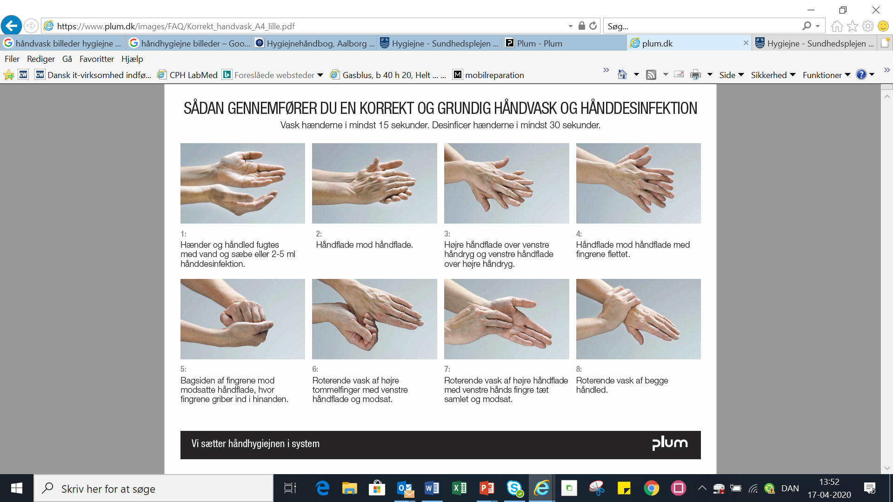
Corona – guidelines
Brug af håndsprit
Hand disinfectant
Skal bruges på rene og tørre hænder
Er hænderne våde, mindskes effekten
Skal gnides ind i ca. 30 sekunder.
Brug de samme greb som ved håndvask.
Must be used on clean and dry hands
Wet hands reduce the effect
Rub in for approx. 30 seconds.
Use the same procedures as for hand washing.

Slide 6
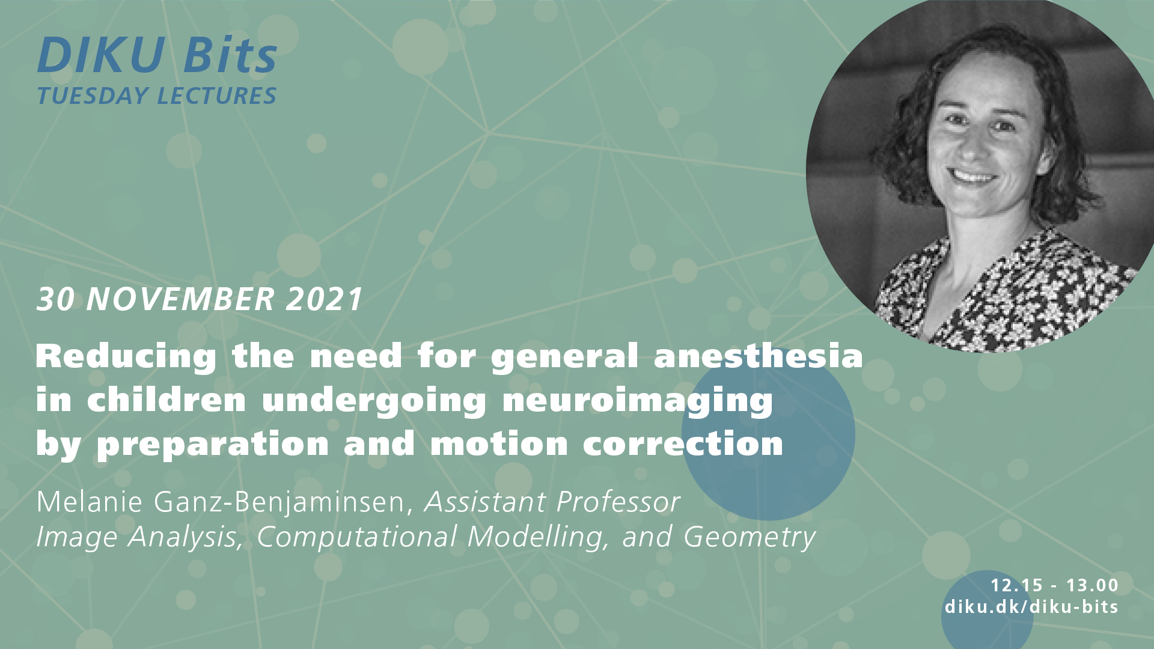
Announcement

Slide 7
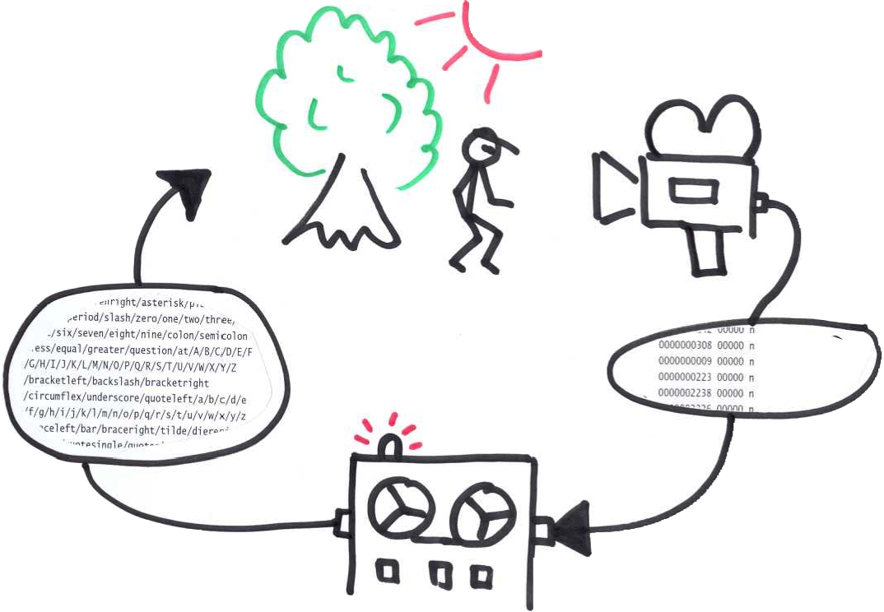
What is this course about?
Computer Vision
Image Procesing
Making computers see
Notes:
Scenario: We observe the world through one or more cameras plugged into a computer and we wish to infer a model description/abstract interpretation of the scene.
We focus on some of the hot research topics in Computer Vision.

Slide 8
Definitions of Computer Vision
Wikipedia: An interdisciplinary field that deals with how computers can be made to gain high-level understanding from digital images or videos. From the perspective of engineering, it seeks to automate tasks that the human visual system can do.
Techopedia: Computer vision is a field of computer science that works on enabling computers to see, identify and process images in the same way that human vision does, and then provide appropriate output. It is like imparting human intelligence and instincts to a computer. In reality though, it is a difficult task to enable computers to recognize images of different objects.
ScienceDaily: Computer vision is the science and technology of machines that see.
Notes:
Notice that the Wikipedia definition includes medical image analysis – this I think is debatable
Thefreedictionary is too thin a definition

Slide 9
Tentative plan for lectures
Week | Content
47 | Filtering, Linear algebra
48 | Image formation, Surface reflection
49 | Features, Descriptors, Matching
50 | Photometric Stereo
51 | Camera models, Homographies, CBIR
1 | Stereo, Color Image Analysis
2 | Segmentation
3 | Convolutional Neural Nets

Slide 10
Schedule: When and where?
Lectures:
Mondays 15:15 – 17:00 in Lille Aud., DIKU
Wednesdays 10:15 – 12:00 Lille Aud., DIKU
Monday 29/11: Lecture moved to AKB Aud 1
Exercises Wednesdays 13:15-15 all at NBI, Jagtvej 155:
Team 1: 3.I, room 164
Team 2: 3.H, room 142
Team 3: 3.I, room 080
You will work individually and in groups with mandatory assignments. Remember to bring your laptop. Also remember paper and pencil.

Slide 11
Mandatory assignments
The course includes 6 mandatory assignments:
A mix of theoretical and practical problems
You have 1-2 weeks to solve each assignment
The first assignment must be made individually. The remaining in groups
Weekly on-line questionnaires to test your knowledge
You can get help during the exercise class
You are encouraged to use the discussion forum

Slide 12
Students Prerequisites
This course is offered on the M.Sc. educations in It & Cognition and Computer Science.
We assume that you know:
Programming at a basic level (either Python, Matlab, or C/C++) plus basic Linear Algebra and Statistics.
Be aware:
You are a mixed crowd with different backgrounds!
You might find some parts trivial and other parts difficult.

Slide 13
Relation to other DIKU courses
Signal and image processing (SIP), Q3
Extremely useful for CS-students, but not a requirement for this course. It is necessary for e.g. ATIA and for thesis work within IP & CV
Machine learning (ML), Q2
Mandatory course for CS-students
Introduction to Data Science (IDS), Q3
ML-course for non-CS-students
Medical image analysis (MIA), Q1
Related topic
Numerical optimization (NO), Q3
Foundation in optimization techniques
Advanced topics in machine learning (ATML), Q1
CS-Thesis preparation course
Advanced topics in Image Analysis (ATIA), Q1
CS-Thesis preparation course
Elements of Machine Learning (bachelor), Q3

Slide 14
How do I pass this course?
You have to pass all assignments in order to pass this course.
Assignment 1 must be solved individually, but we encourage you to discuss it with your fellow students.
In case you do not pass an assignment you will be given a second (but not a third...) chance to submit a new solution assuming that you have made a SERIOUS attempt the first time. This does not apply to the the last assignment.
Final grading for the course is: Pass / Fail based on the assignments.

Slide 15
How much time should I spend on this course?
KU expect that you to use 23 hours / week for a 7.5 ECTS course.
How should I spend my time:
Lectures and exercise classes = 4 + 2 = 6 hours/wk
Preparation and assignment = 23 – 6 = 17 hours/wk
We recommend that you prepare by reading the current weeks material and doing some research on your own, ideally prior to each lecture (approx. 8 hours/wk)
Work on the assignment at home (approx. 9 hours/wk)
Notes:
46 hours! But you have long summer holidays ☺

Slide 16
Course material
We will use the textbook:
D. Forsyth and J. Ponce: Computer Vision - A Modern Approach. Pearson, 2.ed, 2012.
Additional material will be made available in Absalon under the Course material menu item.

Slide 17
Literature for this week
Reading material for this week:
Forsyth and Ponce: 1.1
Tutorial on Linear Algebra
(Forsyth and Ponce: 4.1)
Please check the course plan at Absalon for the literature to next lectures.
Notes:
There is also a new 2012 version of the Forsyth & Ponce book that we recommend if you like some additional material.

Slide 18
Relevant software
Matlab is available from KUnet software library for installation on your laptop
You can do well with Python using:
Numpy, Scipy, Scikit-image, Scikit-learn etc.
You will (probably) also need OpenCV
We recommend Python 3.7 or later. OpenCV is included in recent Anaconda Python packages.
If you prefer C / C++, we recommend the libraries:
OpenCV
VLFeat

Slide 19
How to get help
We use Absalon (access via your KUnet account)
You will find latest lecture plan
Links to lecture slides (usually after the lecture)
Course material (reading material)
Exercise material, and assignment upload
Mandatory questionnaires (when made public)
Links to additional material (reading, programming, etc.)
Discussion board in Absalon for course related topics
Talk with the TAs at class or, if that fails, per e-mail.

Slide 20
Avoid Plagiarism
You are not allowed to copy/steal other peoples work
Copying from the textbook, from the net, or from a classmate is considered plagiarism.
Plagiarism will be revealed, and students will have their study suspended or they will be expelled from the university.
Please look at: https://en.wikipedia.org/wiki/Plagiarism

Slide 21
Examples of plagiarism
Submitting someone's work as their own.
Taking passages from their own previous work without adding citations (self-plagiarism).
Re-writing someone's work without properly citing sources.
Using quotations but not citing the source.
Interweaving various sources together in the work without citing.
Citing some, but not all, passages that should be cited.
Melding together cited and uncited sections of the piece.
Providing proper citations but failing to change the structure and wording of the borrowed ideas enough (close paraphrasing).
Inaccurately citing a source.
Relying too heavily on other people's work, failing to bring original thought into the text.

Slide 22
Questions ?

Slide 23
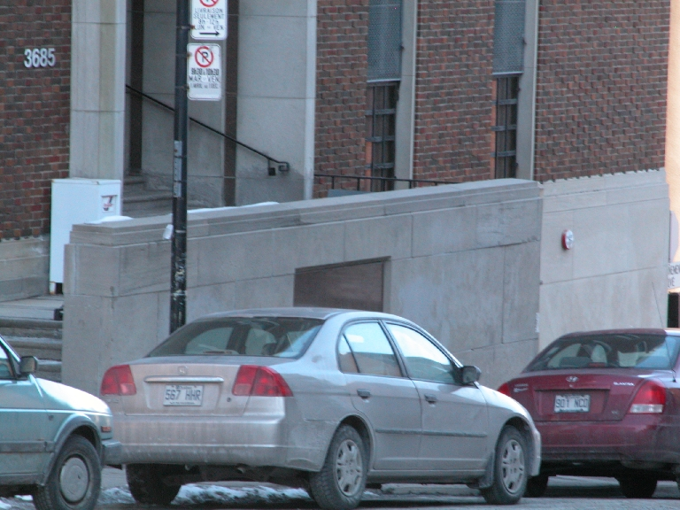
What do you see in this image?
Low level cues: Texture, shading, shadows, occlusion boundaries, etc.
High level interpretation: Objects, foreground-background, 3D perception, etc.
And we did not include motion!
Notes:
Which objects? Cars, a house, stairs, windows, lamp / sign post
Depth / 2.5D interpretation: Cars in front, lamp post behind car, house behind cars and lamp post
High level semantic interpretation of the scene:
What’s the relationship among the objects? “Cars on road in front of house”
Shadows, high lights, changing colors reveal info about 3D structure: Photometric stereo – shape from shading
Foreground-background: Occlusions reveal information about depth
You’re a priori knowledge / internal model also helps you interpret the scene.
“Road sloping downhill”

Slide 24
Example: Object recognition and detection
What is in this image?
And where?
Cars
House
Lamp post
Notes:
Might include localization of the objects
What information do we need here?
Maybe object models?
From detailed to loose models

Slide 25
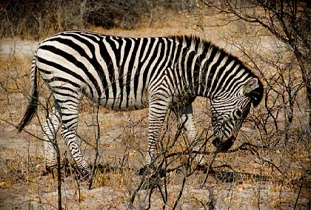
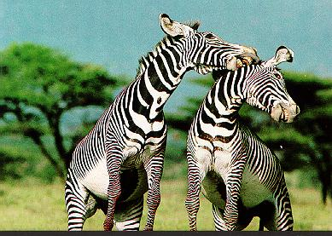
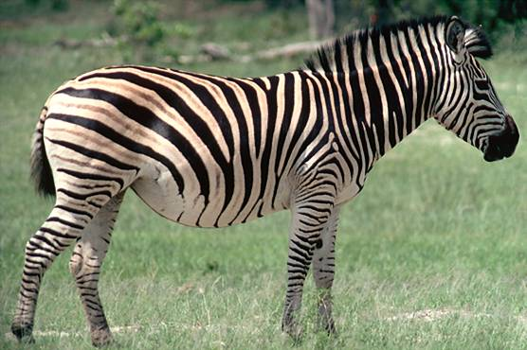
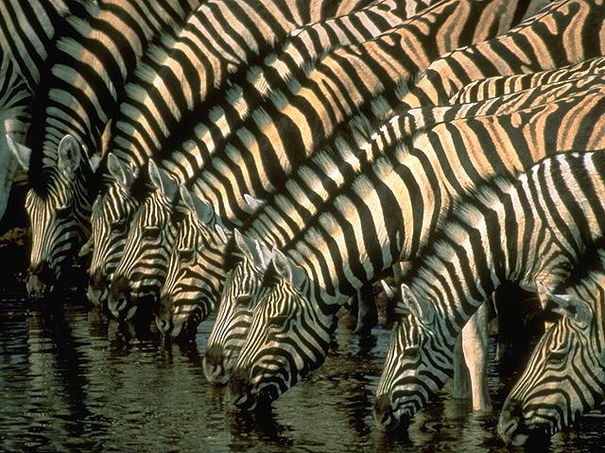
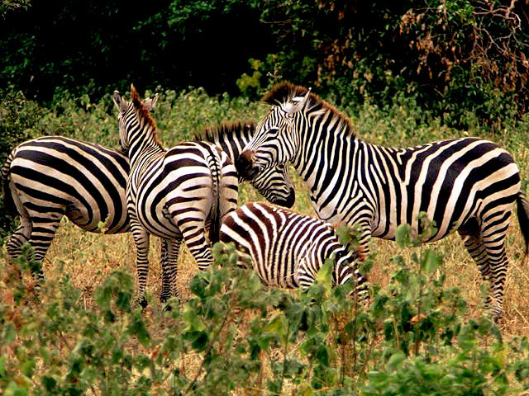
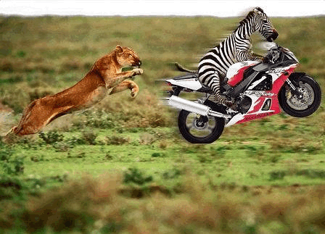
Example: Content-Based Image Retrieval Please return all image that are similar to my query image
Search result
Query image
Notes:
Do we need scene understanding?
This does not necessarily require a complete scene understanding. It can be done solely based on appearance of the dominant objects.

Slide 26
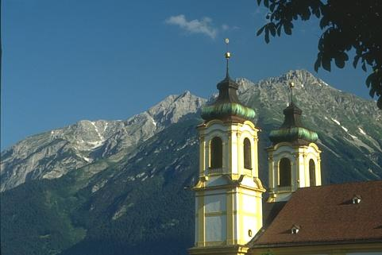

Example: Image Segmentation Information on object boundaries and parts
Notes:
This can be part of the building blocks for object recognition and scene interpretation. Object boundaries and object parts.

Slide 27
Example: 3D reconstruction Stereo or multi-view
Notes:
This is a classic computer vision problem

Slide 28
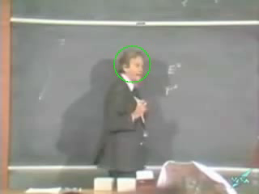
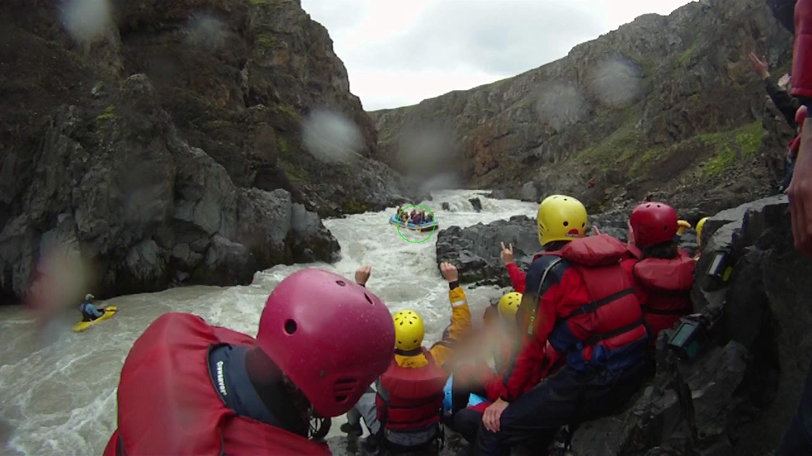
Example: 2D tracking of objects Estimate an objects 2D trajectory in the image over time

Slide 29
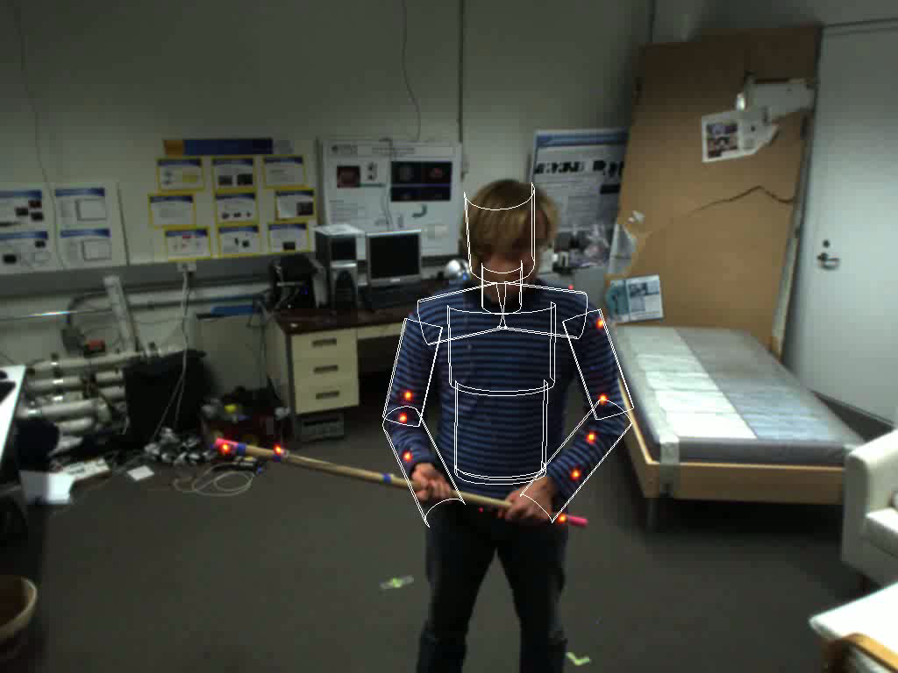
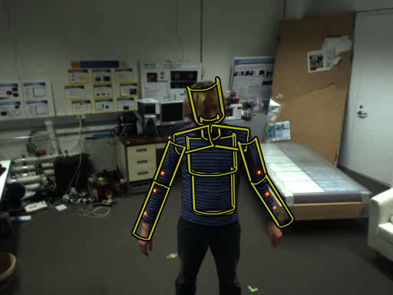
Example: 3D articulated human tracking Estimate 3D pose over time

Slide 30
Lets start from the bottom and go up
Our input data consists of images – so what is an image?

Slide 31
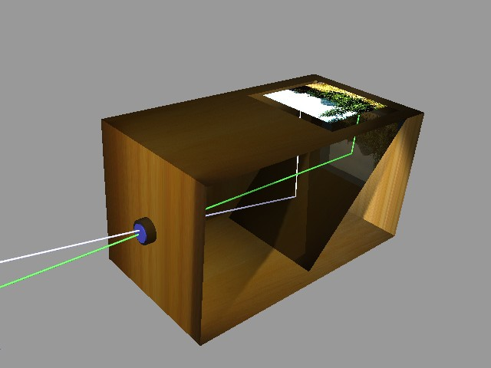
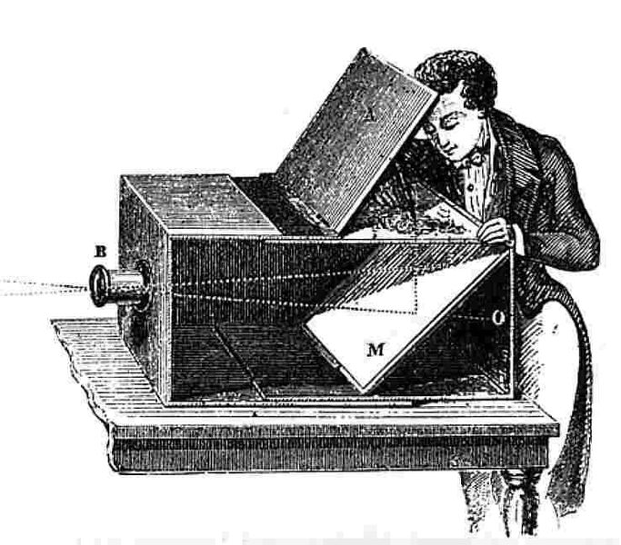
Camera Obscura

Slide 32
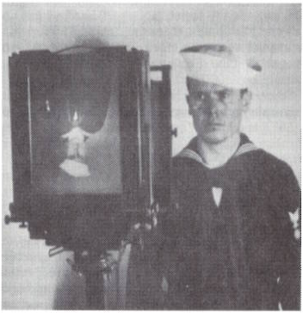
Image formation: The pinhole camera
Notes:
We need a camera and a model of it to understand the process
Camera obscura was the first camera type.
Image plane = photographic glass plate
Image upside-down in this process

Slide 33
Image formation: Camera obscura / pinhole camera
Notice: An image is a perspective projection of the 3D world onto a plane.
Notes:
Light goes through the pinhole and hits the image plane (film, CCD chip, etc)
It is common in theory to work with the virtual image plane (also common in computer graphics). Otherwise image is upside-down
This is a model of perspective projection

Slide 34
Image formation: Some effects of perspective projection
Objects far away appear smaller than close by objects
Notes:
This particular type of projection process is know as perspective projection.
Here are some consequences
A and C have same height viewed through the pinhole O.
However C is closer to O than A by distance d and will appear as long as B (B is twice as long as A and C)

Slide 35
Image formation: Some effects of perspective projection
Parallel lines appear to cross in the image plane (vanishing point)
Notes:
Move image plane in front to ease the interpretation.
Under perspective projection parallel lines appear to meet and cross (vanishing point) and the vanishing point lie somewhere on a horizontal line.
The vanishing point can be outside the image.

Slide 36
Image formation: The pinhole camera model
O : optical center / pinhole
k : optical axis
C’ : image center/principal point
f’ : focal length
Notes:
In camera coordinate system: P=(x,y,z) and P’=(x’,y’,z’)
Focal length = brændvidde
f’/z scales the x,y-coordinates- move the object away from O and P’ moves towards C’ and vice versa
We skip lenses, but this also has an effect on the image formation process

Slide 37
Image formation: Field of view of the camera is
Notes:
We view the scene through a limited aperture.
d the diameter of the image / CCD chip / film and f is the focal length
This gives the opposite cone out into the scene
With real-world optics we have the concept Field of depth = the range of depth where objects appear in focus.
More on camera geometry later in this course

Slide 38
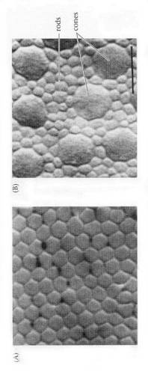
Image formation: The human eye – a stereo camera
Notes:
The pinhole camera is a good analogy of the human eye
Iris is the pinhole
Cornea + lens = optical lens
Cone cells = sensitive to color
Rod cells = high spatial sensitivity, also important for peripheral vision
This is not a course on neurobiology but we will once in a while get inspired by how biological vision systems function. Don’t over do it! We want to build vision systems superior to biological vision ☺

Slide 39
Image formation: The digital camera
Most cameras use charge coupled device (CCD) chip
Notes:
Interpreted as measurements of light energy hitting each photoreceptor cells.
To get color, it is common to use color sensitive filters and either Bayer masks or 3 CCD chips (RGB)

Slide 40

Image representation: An array of pixels (picture elements)
Pixel values:
Gray scale (1 integer)
RGB (3 integers vector)
Notes:
We will think of an image as a function of (x,y) coordinates having intensity values (scalar or vector valued).
In practice it is discritized spatially and intensities are quantized and rescaled to integers.
Notice that it is common to have y axis upside-down – most confusing!

Slide 41
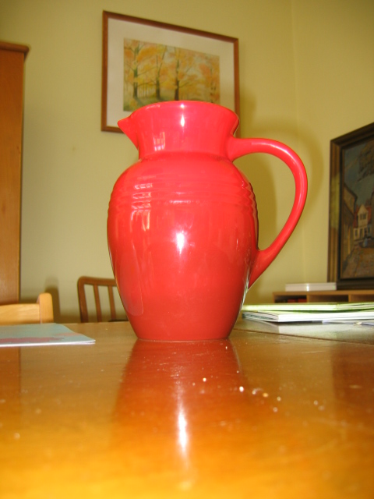
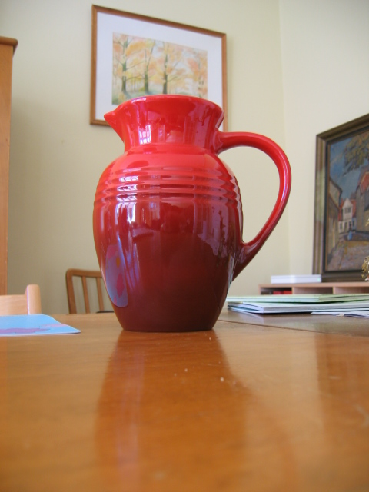
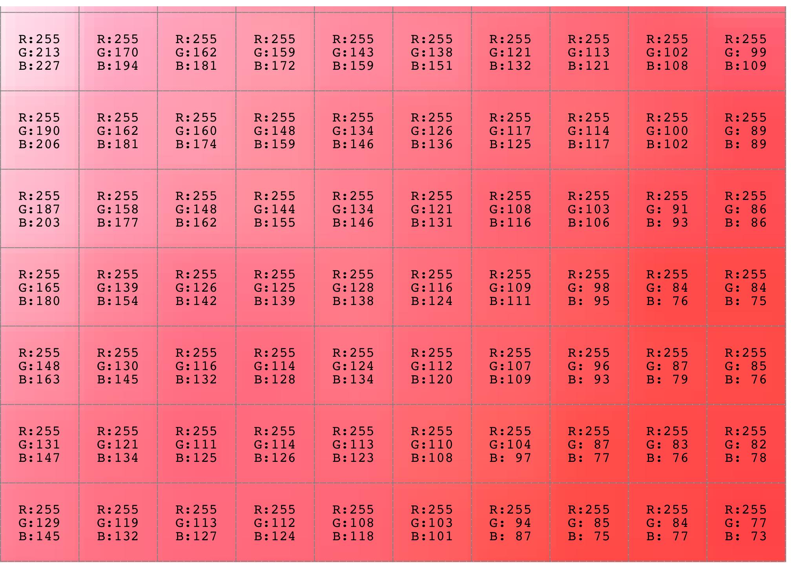
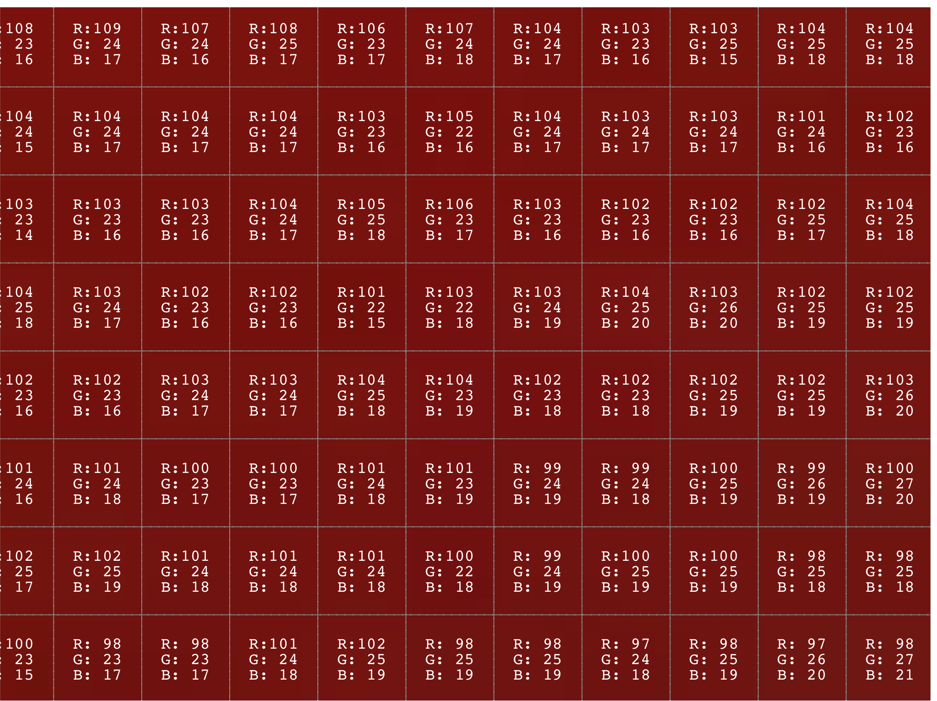
Image representation: An array of pixels (picture elements)
Notes:
It’s the same red pitcher but the lighting is different (flash versus day light).
Only considering the numbers – these two arrays are different.
But it’s the same object!
From pixel level to Marr’s primal sketch and higher order abstractions

Slide 42
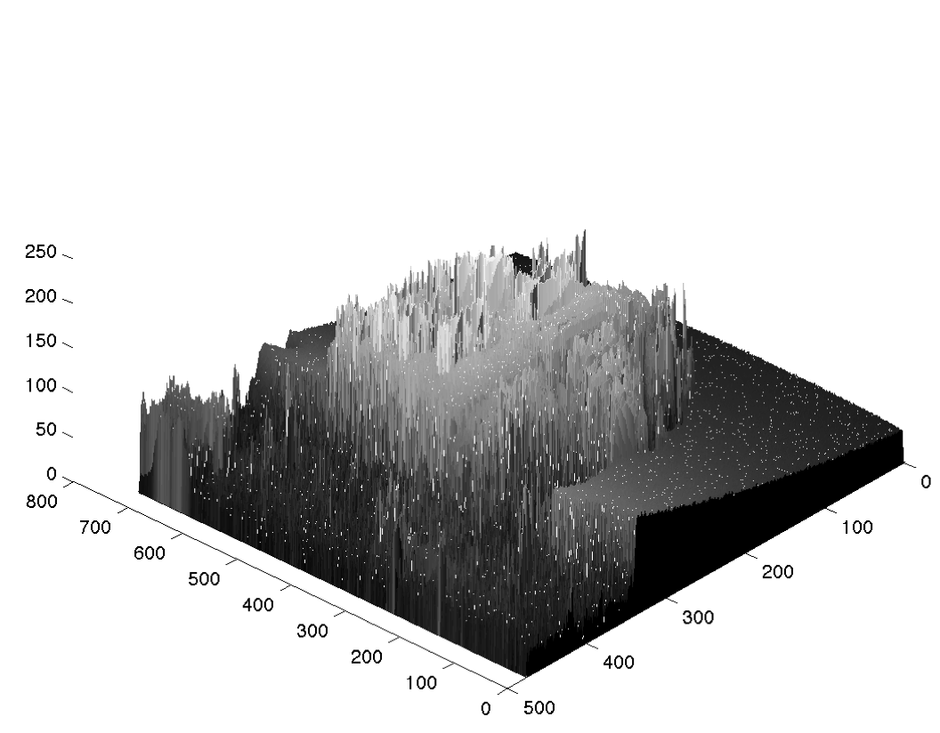
Viewing images as functions
A bunch of numbers in a table is not enough!
Analysis and abstraction is needed
Notes:
Recall from last lecture: We can think of an image as a function of two variables (x,y).
In the following we will switch to gray scale images.
The geometry we are looking for does not depend on color.

Slide 43
Image representation: Marr’s layers of abstraction (1982)
Abstractions
3D Model
Depth
Orientation
Occlusions
2 1/2D sketch
Primal sketch
Segments
Features
Notes:
We actually don’t always need a full 3D model. Many recognition methods is solely based on models of local appearance of the objects. (e.g. DPM’s)
Once we have this hierarchy in place (or at least partially) we can solve some vision tasks!

Slide 44
Mandatory and individual assignment 1:
Training in
Linear Algebra (vectors, matrices etc)
Differential calculus (derivatives)
Python programming
You should know everything of this in advance, but you may have forgot or may have not operative training.

Slide 45
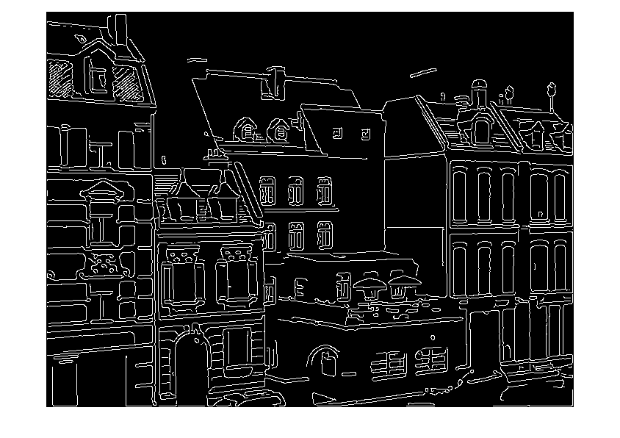
Mandatory assignment 2: Filtering and edge detection
Get acquainted with basic filtering
Extraction of a primitive feature – edges.
Assignment text available at Absalon from next Monday
Notes:
Notice that new regions appear while others are occluded or go out of view.
Start by installing software and make this run before Wednesday!

Slide 46
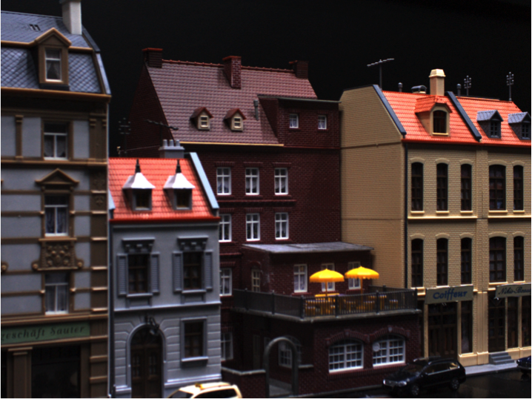
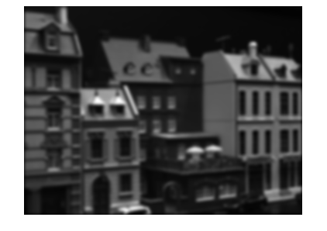
Filtering and edges
Basic image processing
Linear position invariant filtering (aka convolutions) is the most frequent image
processing operation in both classical vision and recent neural networks.
Notes:
90% of all IP is filtering. 90% of all filtering is Gaussian smoothing

Slide 47
What is filtering good for ?
Noise reduction
Elimination of image quantization effects and conversion from integers to floats
Anti aliasing when up/down-sampling
Estimation of image derivatives
Enhancement of specific structures
Detection of image features such as edges and corners

Slide 48
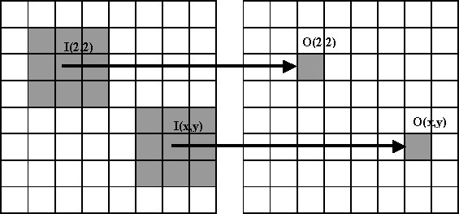
Filtrering
Almost all filtering is local, i.e. the filter response in a pixel is computed based on an image patch centered at the pixel.
Almost all filters are linear and position invariant, implying that the filtering may be described by a convolution.

Slide 49
Convolutions
Filtering by discrete convolution
A filter is defined by a filter kernel h(x,y)
Filtering the image I(x,y) with the kernel h(x,y) is defined as
Consider filter kernels as images
They do not have to be of the same size as the image
Filtering slides the mirrored filter kernel across the image and compute the product sum at each location
The result R(x,y) is called the filter response
R(x,y) is an image of same size as the original image I

Slide 50
Summary
Examples of computer vision problems
Image formation:
Pinhole camera model
The human eye is a “camera”
Image representation:
At the bottom: Digital images as an array of pixels
Pixel values are difficult to interpret
Intro to filtering by convolutions
Wednesday, you will refresh your knowledge on linear algebra and learn new tricks enabling non-trivial computer vision
Remember paper, pencil and laptop for your TA-session

Slide 51
Repeated announcement

Slide 52
Color, Shading and Shadows also concerns us
Notes:
Shading = material reflectance properties and how color changes
Notice the cast shadows and how the texture of the roof changes dramatically.
We need methods that are robust to this kind of variation!

